Slide 1

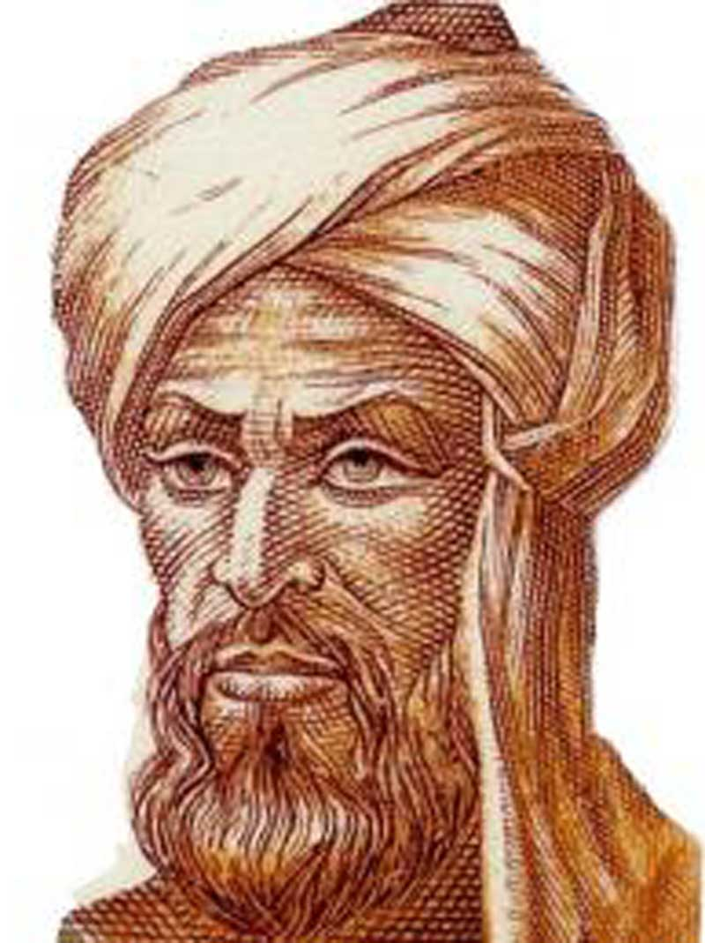
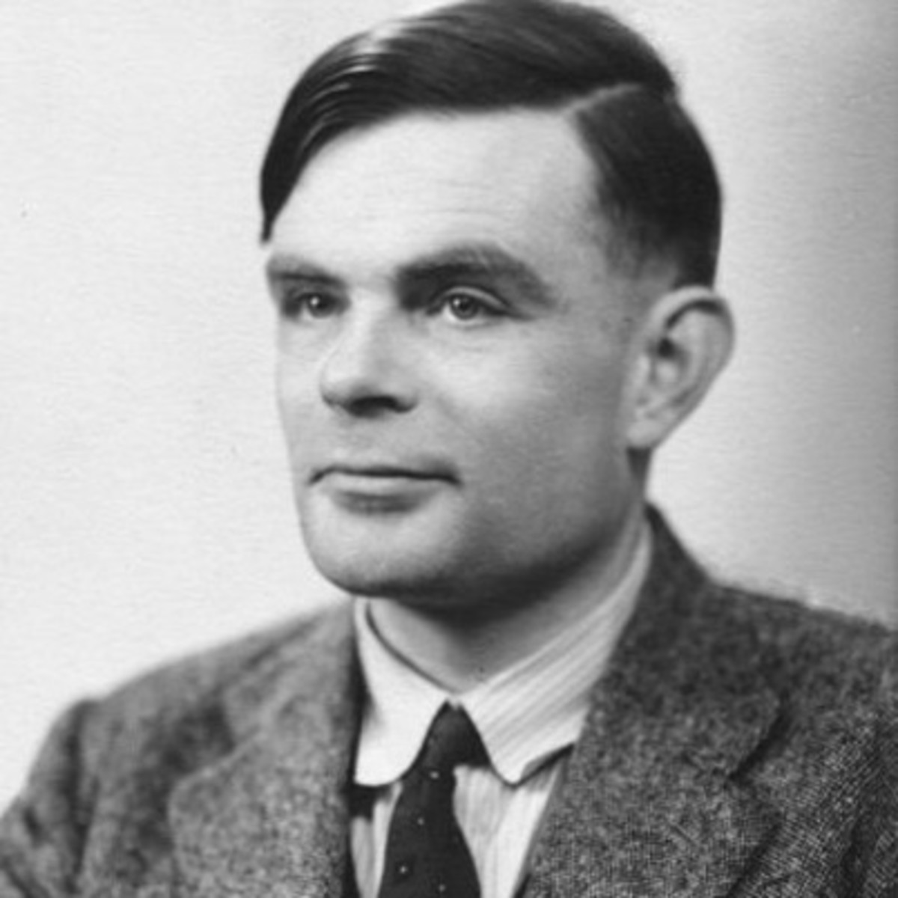
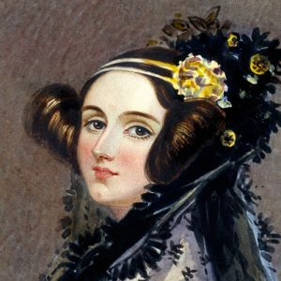
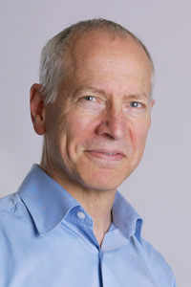
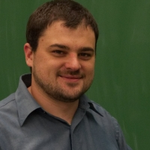
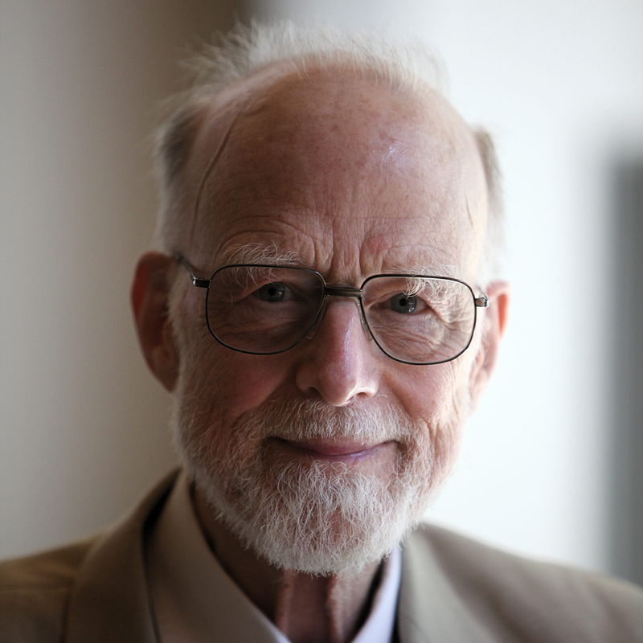
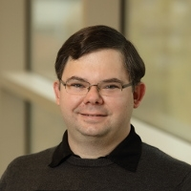
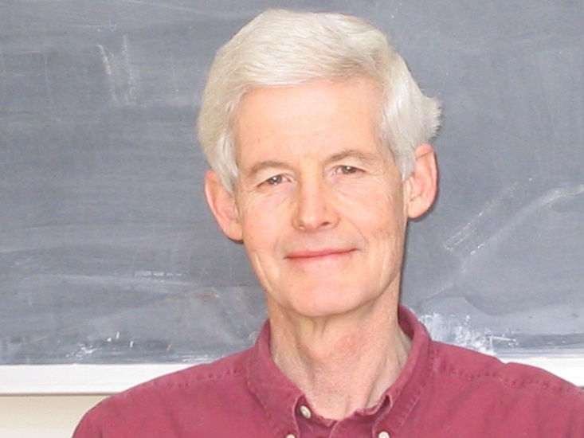
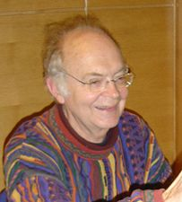
CS4102 Algorithms
Fall 2018

Slide 2
CS4102 Algorithms
Fall 2018
Edsger Dijkstra
Alan Turing
Ada Lovelace
Al-Khwarizmi
Nate Brunelle
Robert Tarjan
Robbie Hott
Tony Hoare
Donald Knuth
Stephen Cook

Slide 3
What is an algorithm?
In mathematics and computer science, an algorithm is a self-contained sequence of actions to be performed. Algorithms can perform calculation, data processing and automated reasoning tasks. [Wikipedia]
Motivating example

Slide 4
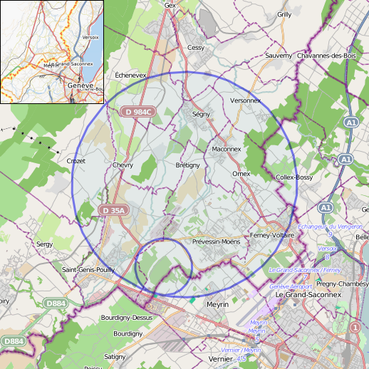
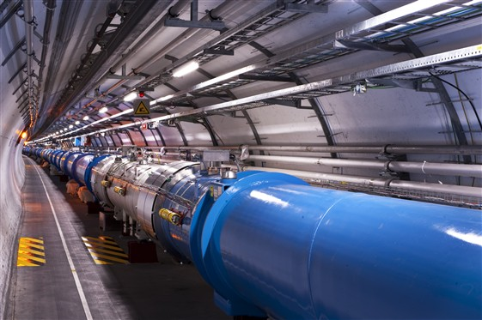

$$π$$
Need an accurate approximation
How much concrete do I need?
4.3km (2.7mi) diameter
Notes:
We’re CERN and we need to build the hadron super collider
Need a circular tube of concrete! 4.3km in diameter
Used to thinking of pi as a number, but it’s irrational, so can’t just use “pi”
We need to calculate digits to a certain approximation to not waste concrete!
- ALGORITHM!

Slide 5

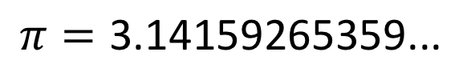
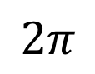
$π$ Approximation Algorithm
$$π=\text{3.14159265359...}$$
1
Circumference =
$$2π$$
Notes:
Let’s start with a unit circle. How would you approximate pi?

Slide 6
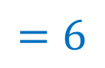



$π$ Approximation Algorithm
$$π=\text{3.14159265359...}$$
$$1$$
$$1$$
$$1$$
$$2π$$
> Perimeter
$$=6$$
Notes:
Maybe we can start with a hexagon and approximate using straight lines.
How what is the perimeter of this hexagon?

Slide 7
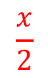
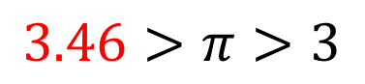
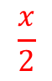
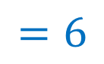
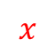
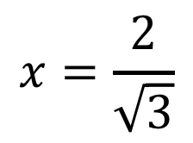
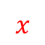
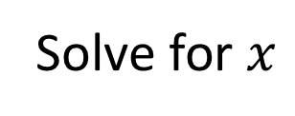

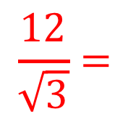
$π$ Approximation Algorithm
$$π=\text{3.14159265359...}$$
1 digit correct
Solve for $x$
$$\frac{x}{2}$$
$$x=\frac{2}{\sqrt{3}}$$
$$x$$
$$1$$
$$\frac{x}{2}$$
$$x$$
$$\frac{12}{\sqrt{3}}=$$
Perimeter >
$$2π$$
> Perimeter
$$=6$$
$$3.46>π>3$$
Notes:
Okay, what about this one?
We get 1 digit of pi approximating using a 6-sided figure.

Slide 8
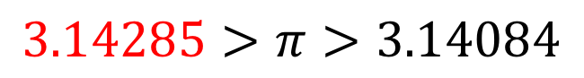
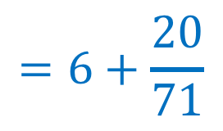
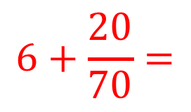
$π$ Approximation Algorithm
$$π=\text{3.14159265359...}$$
3 digits correct
$$6+\frac{20}{70}=$$
$$=6+\frac{20}{71}$$
Perimeter >
$$2π$$
> Perimeter
$$3.14285>π>3.14084$$
Notes:
How about these? If we use 10 sides instead of 6, we can do the calculation and get 3 total digits.
So, how could we get more digits of pi?
Turns out the trend holds in the long-term: ½ digit of pi for each additional sides. For every 2 sides, we’ll get another digit

Slide 9
How to analyze this approach?
How fast do we “converge”?
How much work is needed to do better?
Notes:
This is why we have this course: some algorithms are better than others!
So we should study them and how to make better algorithms
What makes a good algorithm?
So, how can we make the pi approximation better?

Slide 10


Slide 11
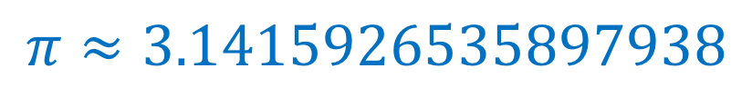
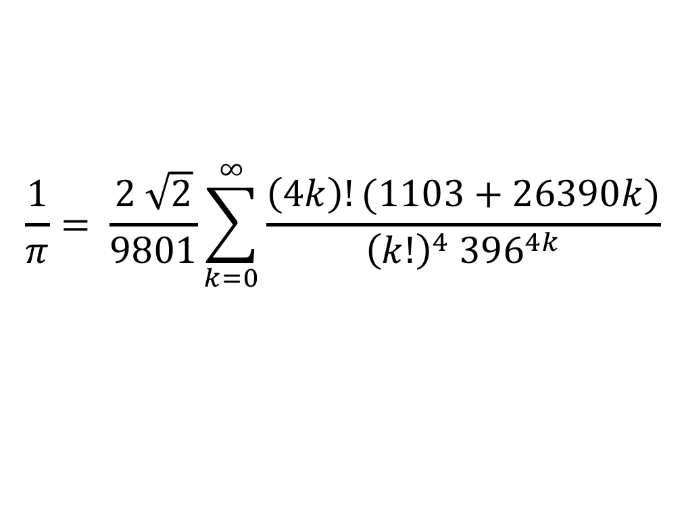
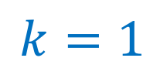

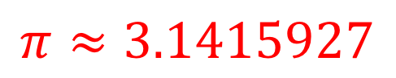
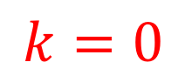
Better $π$ Approximation (Ramanujan)
$$\frac{1}{π}= \frac{2 \sqrt{2}}{9801}\sum_{k=0}^{∞}{\frac{\left(4k\right)!(1103+26390k)}{{\left(k!\right)}^{4} {396}^{4k}}}$$
$$π=\text{3.141592653589793238462643383279502884197169399375105820974944592307816406286208998628}\text{...}$$
$$k=0$$
$$π≈3.1415927$$
8 digits per iteration!
$$k=1$$
$$π≈3.1415926535897938$$

Slide 12
Goals
Create an awesome learning experience
Instill enthusiasm for problem solving
Give broad perspective on Computer Science
Have fun!

Slide 13
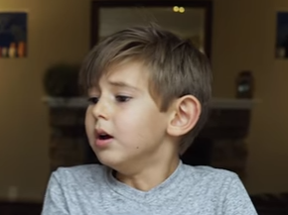
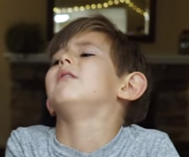
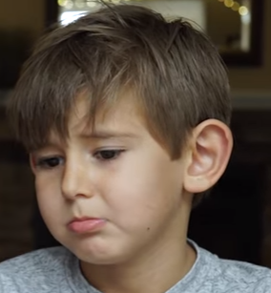
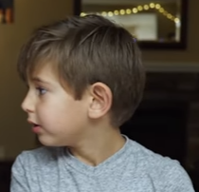
Warning
This will be a very difficult class
Hard material
“Holy Grail” of computer science
Useful in practice
Job Interviews
Lots of opportunities to succeed!
I Quit!
Hopefully not you…

Slide 14
He is very reasonable in what he expects from students and makes the course appropriately hard and time consuming.
The professor was extremely helpful both in and out of class and does not appear to give hard homework for the sake of defeating his students.
The vast majority of the time he was able to explain the hard concepts effectively and made me more motivated and confident about the rigorous topics during the semester.
The class is very difficult. It's not easy, but it's important material.
The homework felt brutally difficult compared to the lecture and midterm, but was probably so for a reason.
This class was the perfect balance of being true to the difficult course material but entirely fair
The class was pretty difficult, but I felt like I was given more than enough resources to succeed (and do better than I actually did lol)
He was also incredibly flexible with his assignments knowing full well that his assignments were incredibly difficult
The homework was very difficult and I think a little too hard to get an A in
GETTING AN A IN THIS CLASS IS HARDER THAN SNEAKING INTO THE BASE OF NSA WITH OR WITHOUT GETTING SHOT

Slide 15
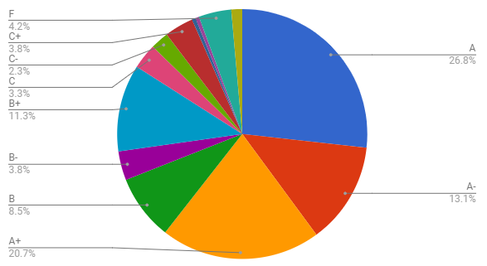
While difficult, students have done well…

Slide 16
Office Hours
Prof. Hott
Rice 210
Th 11am-12:30pm (this class)
W 2pm-3:30pm (2110)
By appointment
Prof. Brunelle
Rice 209
W 4pm-6pm
By appointment

Slide 17
Requirements
Discrete Math (CS 2102)
Data Structures (CS 2150)
Derivatives, series (Calc I)
Tenacity
Inquisitiveness
Creativity

Slide 18
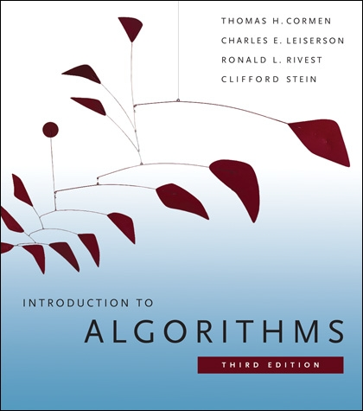
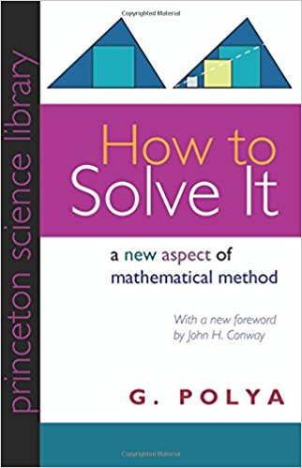
Textbook
No textbook required
Highly recommended:
Polya. How to Solve It.
Cormen et al. (CLRS) Introduction to Algorithms. Third Edition.

Slide 19
10% Extra Credit

Slide 20
Homework
11 assignments total
Mix of written and programming assignments
Written:
2/3 of all assignments
Must be typeset in LaTeX (tutorial is HW0)
Submit as a pdf and a zip folder containing tex file and any supplements
Submissions without both attachments (pdf, zip) will not be graded
Programming:
1/3 of all assignments
Must implement in Python or Java

Slide 21
Academic Integrity
Collaboration Encouraged!
Groups of up to 5 per assignment
List your collaborators
Write-ups/code written independently
Be able to explain any solution you submit!
DO NOT seek published solutions online

Slide 22
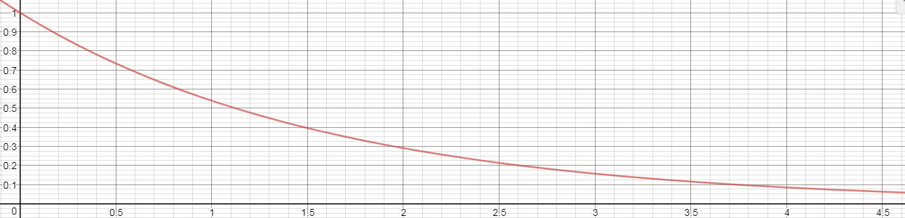
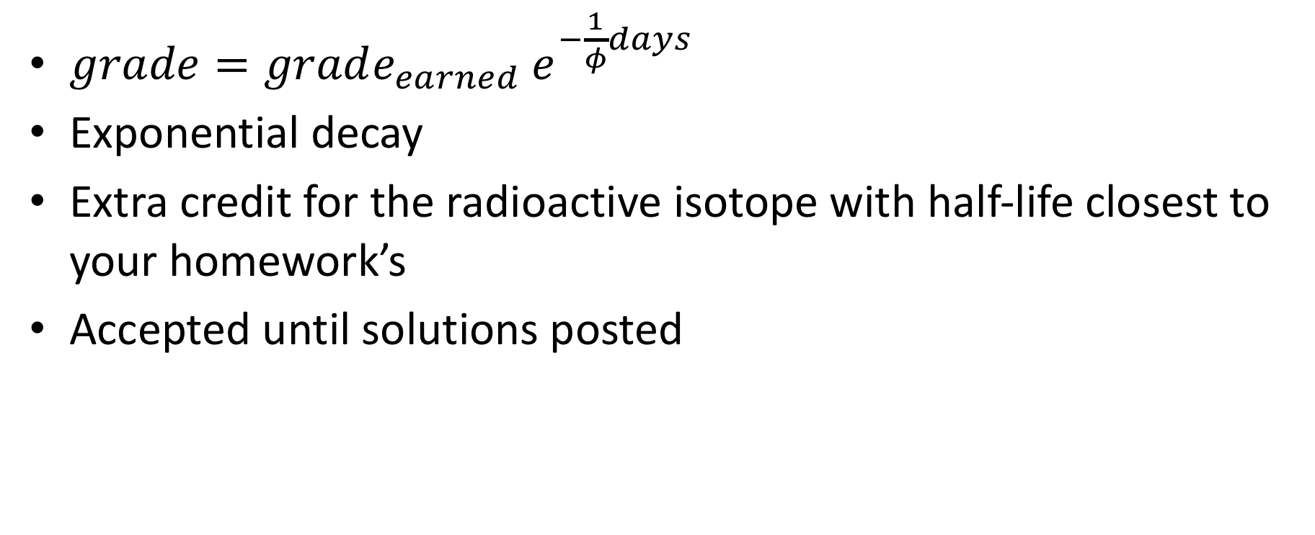
Late Policy
$grade=grade_{earned} e^{−\frac{1}{φ}days}$
Exponential decay
Extra credit for the radioactive isotope with half-life closest to your homework’s
Accepted until solutions posted

Slide 23
Exams
Midterm
Est. October 16
In-class / take-home hybrid
Final
Registrar’s official date/time
Monday 12/10, 2-5pm (9:30am section)
Monday 12/17, 9am-12pm (2pm section)
You must show up to the correct section’s exam
midterm and final

Slide 24
Regrades
Conducted in person w/ Prof Hott or Prof Brunelle
Tuesday 4pm-5pm
By appointment

Slide 25
Extra credit
Given for extraordinary acts of engagement
Good questions/comments
Quality discussions
Problem solving session attendance
Analysis of current events
References to arts
Extra credit projects
Slide corrections
Etc. Just ask!
Email: extra.credit.cs4102@gmail.com

Slide 26
Feedback
I am not a course dictator, I am a civil servant
I’m open to any suggestion to help you learn
Let me know!
In person
Email
Piazza
Anonymous feedback (as long as it’s constructive)

Slide 27
Attendance
How many people are here today?
Naïve algorithm
Everyone stand
Professor walks around counting people
When counted, sit down
Run time?
Class of n students
O(n)
Other suggestions?

Slide 28
Better Attendance
Everyone Stand
Initialize your “count” to 1
Greet a neighbor who is standing: share your name, full date of birth(pause if odd one out)
If you are older: give “count” to younger and sit. Else if you are younger: add your “count” with older’s
If you are standing and have a standing neighbor, go to 3

